Slide 1
Voting Rights Policy & The Law ______________________________
Matt Barreto & Chad Dunn
September 26, 2019

Slide 2
Course Overview
Year-long course across Fall, Winter, Spring (Summer)
Meeting every-other Thursday
Taught from the perspective of social science research, and civil rights and voting rights
Cases we have worked on…
Learn the history, legal interpretations, practical application of VRA and CVRA

Slide 3
Course Overview
Learn the elements of proof of a successful voting rights challenge
Narrow down jurisdictions of interest
Students are going to make the case – write a complaint – for why their jurisdiction violates the CVRA or VRA
File a lawsuit against unlawful jurisdictions
(Could spill over into Summer 2020?)

Slide 4
The Federal Voting Rights Act
15th Amendment: the right to vote shall not be denied or abridged on the basis of race, color or previous condition of servitude
1964 Civil Rights Act: Title I calls for any qualifications for voter registration to be applied equally to all, prohibits a voter from being rejected for non-material errors on an application, and outlines specific requirements for literacy tests.

Slide 5
The Federal Voting Rights Act
1964 CRA had no enforcement mechanism of federal oversight on the acts requirements
1965 Voting Rights Act, Section 2
(a) No voting qualification or prerequisite to voting or standard, practice, or procedure shall be imposed or applied by any State or political subdivision in a manner which results in a denial or abridgement of the right of any citizen of the United States to vote on account of race or color, or in contravention of the guarantees set forth in section

Slide 6
The Federal Voting Rights Act
1965 VRA
(b) A violation of subsection (a) is established if, based on the totality of circumstances, it is shown that the political processes leading to nomination or election in the State or political subdivision are not equally open to participation by members of a class of citizens protected by subsection (a) in that its members have less opportunity than other members of the electorate to participate in the political process and to elect representatives of their choice. The extent to which members of a protected class have been elected to office in the State or political subdivision is one circumstance which may be considered: Provided, That nothing in this section establishes a right to have members of a protected class elected in numbers equal to their proportion in the population.

Slide 7
VRA Section 5
Preclearance
SEC. 5. Whenever a State or political subdivision with respect to which the prohibitions set forth in section 4(a) are in effect shall enact or seek to administer any voting qualification or prerequisite to voting, or standard, practice, or procedure with respect to voting different from that in force or effect on November 1, 1964, such State or subdivision may institute an action in the United States District Court for the District of Columbia for a declaratory judgment that such qualification, prerequisite, standard, practice, or procedure does not have the purpose and will not have the effect of denying or abridging the right to vote on account of race or color, and unless and until the court enters such judgment no person shall be denied the right to vote for failure to comply with such qualification, prerequisite, standard, practice, or procedure:

Slide 8
VRA Section 5
Shelby v. Holder
Formula in Section 4b was outdated
Therefore Section 5 preclearance not in effect
“If Congress had started from scratch in 2006, it plainly could not have enacted the present coverage formula.” According to the Court, “Regardless of how to look at the record no one can fairly say that it shows anything approaching the ‘pervasive,’ ‘flagrant,’ ‘widespread,’ and ‘rampant’ discrimination that faced Congress in 1965, and that clearly distinguished the covered jurisdictions from the rest of the nation.”

Slide 9
VRA Section 5
Shelby v. Holder
Dissent argued that decades of SCOTUS decisions say they should defer to Congress, which had compiled extensive record of contemporaneous discriminatory voting rights practices
“[t]hrowing out preclearance when it has worked and is continuing to work to stop discriminatory changes is like throwing away your umbrella in a rainstorm because you are not getting wet.”

Slide 10
Section 203
Amended in 1975 and added Section 203
“Whenever any State or political subdivision [covered by the section] provides registration or voting notices, forms, instructions, assistance, or other materials or information relating to the electoral process, including ballots, it shall provide them in the language of the applicable minority group as well as in the English language.”

Slide 11
California Voting Rights Act
Voting Rights Policy & The Law

Slide 12
The California Voting Rights Act
Federal VRA has been interpreted more narrowly
California Voting Rights Act signed in 2002
Allows civil rights groups to bring lawsuits under California law against at-large jurisdictions
If they can prove the at-large system is preventing minority groups from getting elected to office
Has resulted in considerable increases in Latino elected officials at local level in California

Slide 13
The Court Structure
Voting Rights Policy & The Law

Slide 14
The Court Structure
Federal Court State Court
District Court Superior Court
Court of Appeals Court of Appeals
U.S. Supreme Court State Supreme Court
U.S. Supreme Court

Slide 15
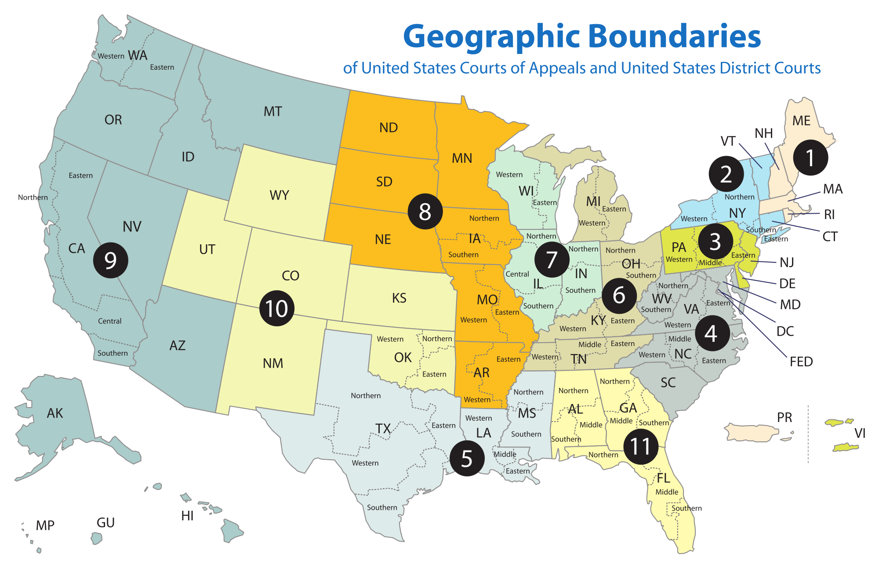

Slide 16
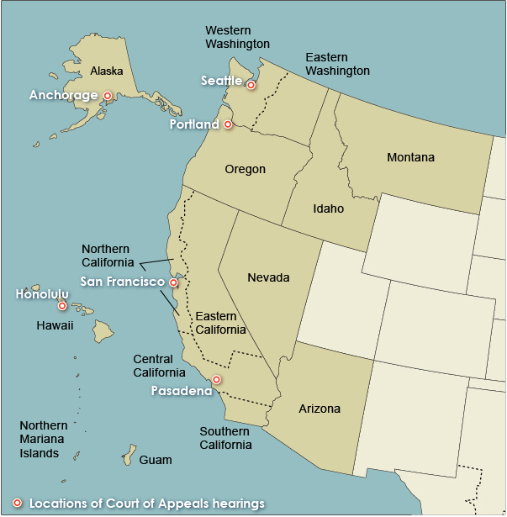
9th Circuit Court
Jurisdictions we might consider:
WA
OR
CA
NV
AZ
ID? MT? HI? AK?

Slide 17
Next steps for this class
What jurisdictions are not in compliance with the Federal or California Voting Rights Act?
Lack of minority representation
Lack of language assistance (Section 203)
Example:
Riverside, CA
Dodge City, KS

Slide 18
Thank you! Contact us:
Prof. Barreto: barretom@ucla.edu
Prof. Dunn: cdunn@luskin.ucla.edu
Voting Rights Policy & The Law

