Slide 1
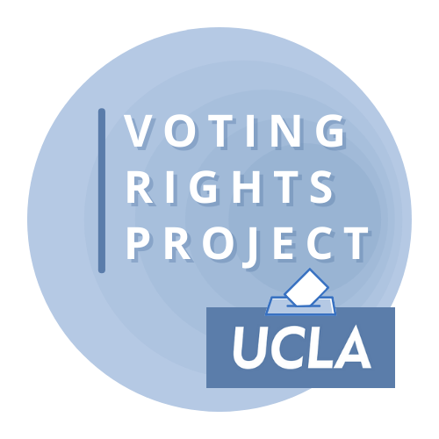
Voting Rights Policy & The Law
Matt Barreto & Chad Dunn
November 18, 2021

Slide 2
Overview
Purcell Principle/Timeliness of Action
Discussion of Jurisdictions
But first… any voting rights / redistricting in the news?

Slide 3
Before Purcell
A practice that violates federal law must be remedied “root and branch”.
Burden shifts to the government to present an effective remedy: “The burden on a school board today is to come forward with a plan that promises realistically to work, and promises realistically to work now.” Green v. Cty. Sch. Bd. of New Kent Cty., Va., 391 U.S. 430, 439 (1968)
Once a violation is found, a remedy must take effect immediately.
Including delaying election deadlines or moving the election all together.

Slide 4
Purcell (2006)
Challenge to Arizona Proposition 200 where voters had approved a new law requiring voters to 1) prove citizenship to vote and 2) provide a photo voter ID.
DOJ Precleared the new law under Section 5
Trial Court did not rule on Section 2 case until October 11, 2006
Injunction denied: “plaintiffs have shown a possibility of success on the merits of some of their arguments but the Court cannot say that at this stage they have shown a strong likelihood.”
Ninth Circuit issues 4 sentence order enjoining Prop 200 pending appeal.

Slide 5
Purcell (2006)
“A State indisputably has a compelling interest in preserving the integrity of its election process.” Eu v. San Francisco County Democratic Central Comm., 489 U. S. 214, 231 (1989). Confidence in the integrity of our electoral processes is essential to the functioning of our participatory democracy. Voter fraud drives honest citizens out of the democratic process and breeds distrust of our government. Voters who fear their legitimate votes will be outweighed by fraudulent ones will feel disenfranchised. “[T]he right of suffrage can be denied by a debasement or dilution of the weight of a citizen’s vote just as effectively as by wholly prohibiting the free exercise of the franchise.” Reynolds v. Sims, 377 U. S. 533, 555 (1964). Countering the State’s compelling interest in preventing voter fraud is the plaintiffs’ strong interest in exercising the “fundamental political right” to vote. Dunn v. Blumstein, 405 U. S. 330, 336 (1972) (internal quotation marks omitted). Although the likely effects of Proposition 200 are much debated, the possibility that qualified voters might be turned away from the polls would caution any district judge to give careful consideration to the plaintiffs’ challenges.”

Slide 6
Purcell in Practice
About a month before the 2014 election, the United States Supreme Court issued a series of four extraordinary orders in election law cases.
Without any explanation, the Court:
1) stayed a district court order which would have required Ohio to restore extra days of early voting
2) stayed a Fourth Circuit order (partially reversing a district court) which would have restored same-day voter registration and the counting of certain provisional ballots in North Carolina
3) vacated a Seventh Circuit stay of a district court order barring Wisconsin from implementing its new strict voter identification law
4) refused to vacate a Fifth Circuit stay of a district court order which would have barred Texas from continuing to use its new strict voter identification law

Slide 7
Purcell in Practice
Veasey v. Abbott, Texas Voter ID case
Injunction entered after weeks of trial
Stay entered by Fifth Circuit
Justice Ginsburg on her dissent from U.S. Supreme Court order refusing to lift stay:
“First this case was unlike others because it had gone through a complete 9 day trial, reams of evidence, and an excellent decision written by the district court. This was a new system for Texas. From 2003-2013, they have a voter id that was reasonable. There were many things you could present. The new law cut back drastically on that. There had never been a federal election held under the new law. There had been local elections with very small turnout. So the poll watchers [workers?-Ed] were more familiar with old procedur[e]. So I didn’t think this case fell into the mold of we can’t disturb an election. There had been very little in the way of educational efforts, so that people knew what the new law required, so that the poll watchers would know. So I thought that the old system would involve less disruption than this never done-in-a-federal-election-before [system].”

Slide 8
RNC v. DNC
April 2020 COVID-19 Pandemic setting in
Wisconsin maintains April 7, 2020 Presidential Primary Election
Rush of vote by mail applications (150,000 is a few days)
Election workers will not be able to deliver ready to be voted ballots before election day
Mail is delayed/Stay at home order until April 24
Plaintiffs (DNC) ask that deadline to receive voted ballot be extended and that no post-mark deadline be required
Benchmark law had no postmark deadline, just receipt deadline
District Court enters injunction that 1) extends receipt deadline to April 13 but does not impose post-mark deadline (April 3)
State government does not oppose but RNC intervenes
7th Circuit declines to stay injunction (April 3)
Supreme Court lifts injunction after days of implementation

Slide 9
RNC v. DNC
“This Court has repeatedly emphasized that lower federal courts should ordinarily not alter the election rules on the eve of an election. See Purcell v. Gonzalez, 549 U. S. 1 (2006) (per curiam); Frank v. Walker, 574 U. S. 929 (2014); Veasey v. Perry, 574 U. S. __ (2014).”
Justice Ginsburg’s Dissent: “[T]he Court’s order cites Purcell, apparently skeptical of the District Court’s intervention shortly before an election. Nevermind that the District Court was reacting to a grave, rapidly developing public health crisis. If proximity to the election counseled hesitation when the District Court acted several days ago, this Court’s intervention today—even closer to the election—is all the more inappropriate.”

Slide 10
Purcell: Either too late or too early
Voting rights Plaintiffs can never find the goldilocks zone.
When filing early, the government defends that election conditions are not yet clear and/or full election rules needed to determine burdens are not yet fully developed.
When filing later after rules develop, the Court rules that any relief is too late.
When relief is provided timely in a lower court, the higher court justifies reversing that relief because of its later review.

Slide 11
Purcell: Unprincipled Principle
TDP v. Abbott (filed April 7, 2020): 26th Amendment Claim on Texas’s age restriction to vote by mail
Injunction entered May 19 by Judge Fred Biery
Fifth Circuit issues stay of Injunction on June 4, 2020:
“Just days after themselves obtaining an injunction intervening in forth-coming elections, the plaintiffs ambitiously suggest that we should now refrain from intervening ourselves, given “the proximity of a forthcoming election and the mechanics and complexities of state election laws.” That invocation “reminds us of the legal definition of chutzpah: . . . a young man, convicted of murdering his parents, who argues for mercy on the ground that he is an orphan.” In any case, we “would prefer not to [intervene], but when a lower court”—at the plaintiffs’ behest—erroneously “intervenes and alters the election rules so close to the election date, our precedents indicate that [we], as appropriate, should correct that error.” Republican Nat’l Comm., 140 S. Ct. at 1207.”

Slide 12
Voting Rights Policy & The Law
Matt Barreto & Chad Dunn
November 18, 2021

