Slide 1
Voting Rights Policy & The Law
Matt Barreto & Chad Dunn
October 19, 2023

Slide 2
Today’s overview
Review: Arlington Heights factors
District population size requirements
Social Explorer – Mapping your jurisdiction
But first… any voting rights / redistricting in the news?

Slide 3
Arlington Heights REview
Court applied a discriminatory intent test
the official action affects a protected class in greater proportion than others, and if such is established;
that the official action was intended to discriminate against a suspect or protected class.
Provided Non-exhaustive factors
The Court must be careful that it does not “miss[] the forest in carefully surveying the many trees.” N.C. State Conf. of NAACP v. McCrory, 831 F.3d 204 (4th Cir. 2016)

Slide 4
Arlington Heights review
“The impact of the official action,” especially “whether it bears more heavily on one race than another” (but “impact alone is not determinative”)
“The historical background of the decision, particularly if it reveals a series of official actions taken for invidious purposes”
“The specific sequence of events leading up the challenged decision”
“Departures from the normal procedural sequence” or “[s]ubstantive departures”
“The legislative or administrative history . . .especially where there are contemporary statements by members of the decision-making body, minutes of its meetings, or reports”

Slide 5
Equal Protection – 14th Amendment
When it comes to creating districts, keep in mind:
Equal Protection — 14th Amendment Claim
A state redistricting plan with population deviations among districts that are greater than 10% is prima facie unconstitutional.
A federal redistricting plan (US House) must be as close to equal as possible
Baker v. Carr 1962; Reynolds v. Sims 1964

Slide 6
Equal Protection – 14th Amendment
When it comes to creating districts, keep in mind:
When you consider districts in your locale:
What is the total population?
How many total districts are there?
City has 29,535 total population
There are 5 city council districts
What is the total population target per district?
What is the min (95%) and max (105%) population?
5,907
5,612
6,202

Slide 7
Social Explorer

Slide 8
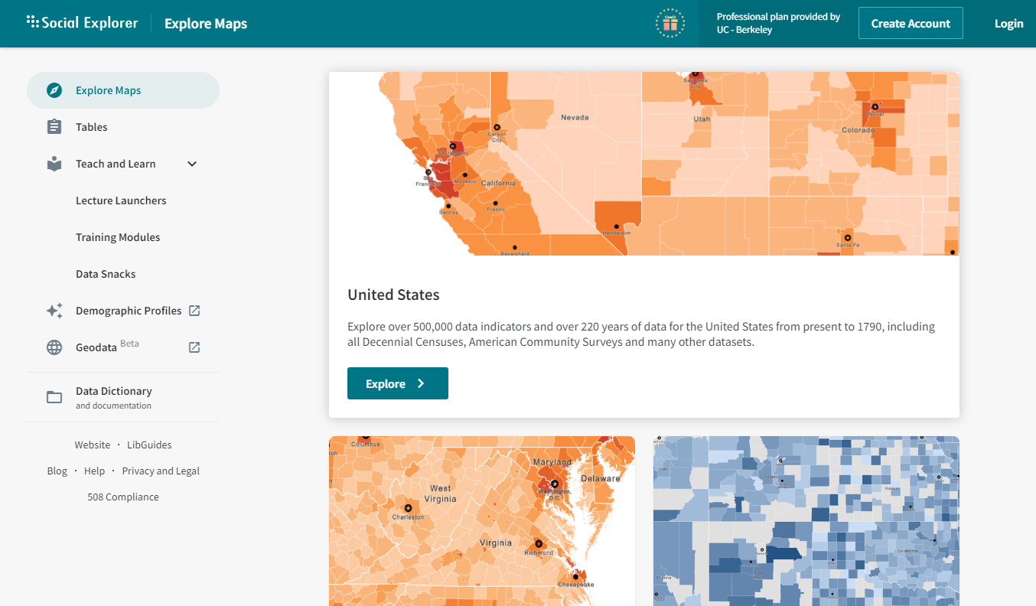
Social Explorer

Slide 9
Connecting from off campus
You have to configure your web browser for proxy access to allow it to verify your UCLA credentials
https://www.library.ucla.edu/computers-computing-services/connect-campus
https://www.it.ucla.edu/it-support-center/services/proxy-server
https://it.ucla.edu/it-support-center/services/virtual-private-network-vpn-clients
You are going to copy/paste into browser settings: http://proxy.ucla.edu/cgi/proxy

Slide 10
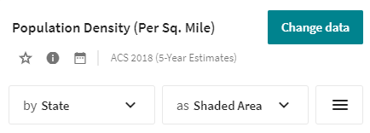
Using Social Explorer
*As of October 2023
Social Explorer
https://www.socialexplorer.com/explore-maps
Click Explore
Top Left, Click Change data
Click on Race
Scroll down to Hispanic or Latino by Race
Under Not Hispanic or Latino
Click on White Alone

Slide 11
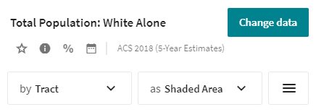
Using Social Explorer
*As of October 2023
Social Explorer
Map will turn shades of orange
Click the “Shaded Area”
Where it says Color palette, click SE Orange
Scroll to “Diverging” and choose Complementary (red / green)
Now slowly zoom in to your county/city jurisdiction
Shading will change to Tract as you zoom in
Change to Census Block Group

Slide 12
Using Social Explorer
*As of October 2023
Social Explorer
To augment view of shading, click Cutpoints
You can reduce classes to 9 or 7 (your choice)
You can position breaks at key population intervals to help the audience observe contrast around 50%

Slide 13
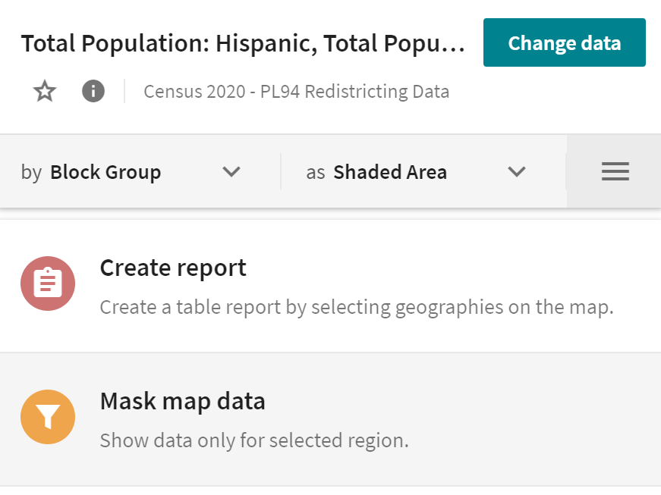
Using Social Explorer
*As of October 2023
Only show one County:
First click the 3 lines (menu)
Next Click Mask map data
In the Mask menu:
Under Geography → Select County
Then Click on your county and click “Done”
Back on the main page you might need to change “by” back to Block Group (it might revert to County)

Slide 14
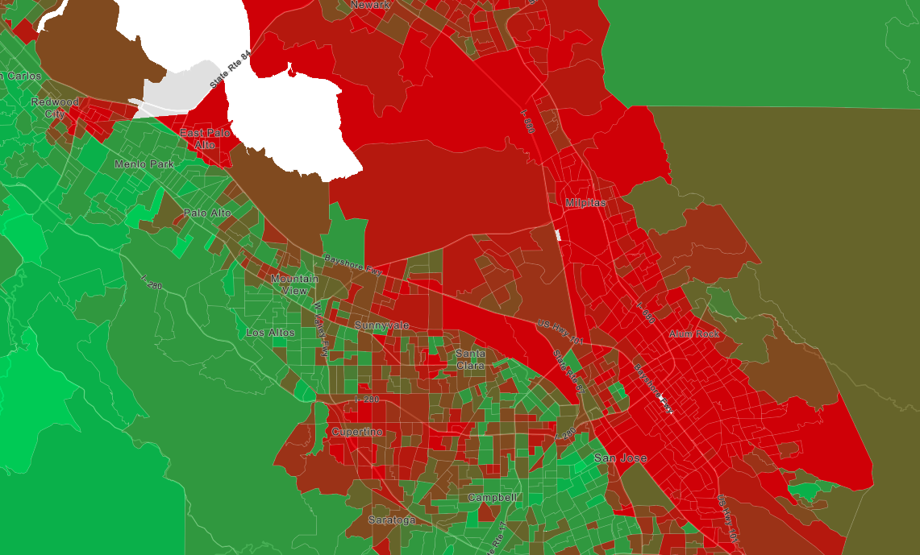
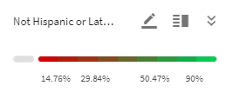
Example of Santa Clara/San Jose
Census block groups shaded by percent White
Red = low percent White
Green = high percent White

Slide 15
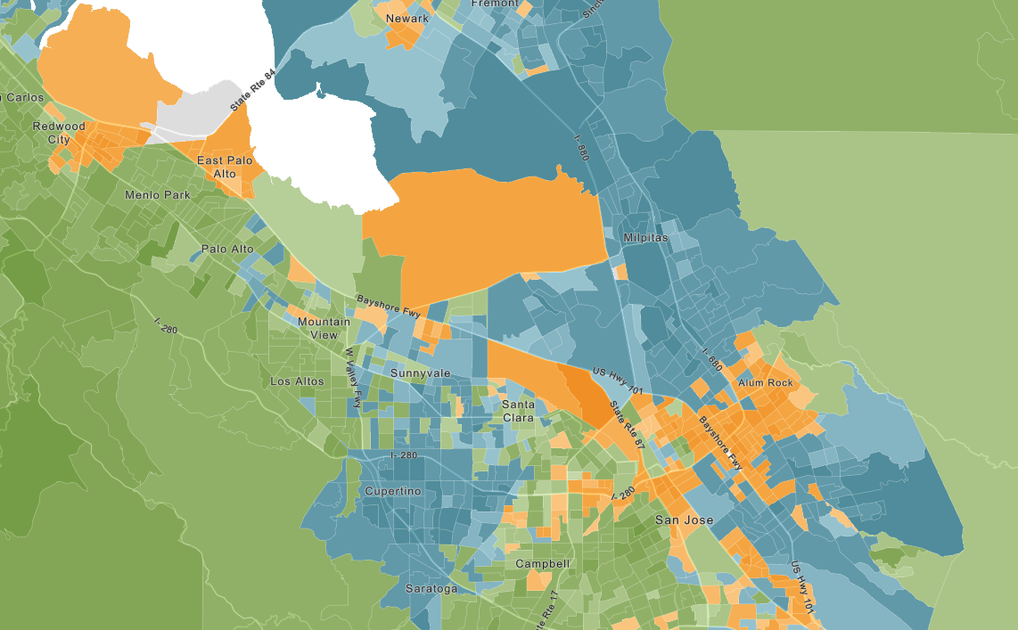
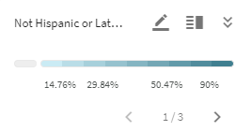
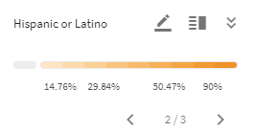
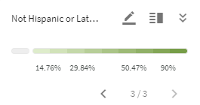
Example of Santa Clara/San Jose
Change data to add multiple racial groups:
Asian alone
White alone

Slide 16
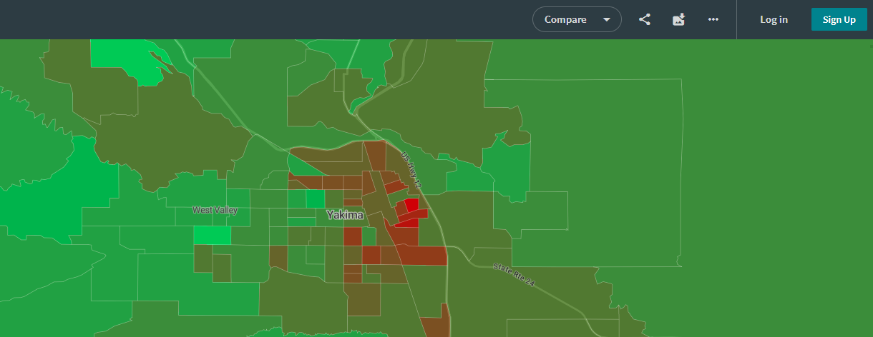
Using Social Explorer
*As of October 2023
Export or share your map:
Export image
Create link

Slide 17
For next week:
Continue with 2 jurisdictions you are studying
Report both Total Pop CVAP detail
Create race maps of each from Social Explorer
Does your jurisdiction appear to meet Gingles 1?
Can you draw one district, or maybe two?
Use Google Satellite to learn more about communities
Read Hood et al. 2017 “From Legal Theory to Practical Application.” Social Science Quarterly

Slide 18
Voting Rights Policy & The Law
Matt Barreto & Chad Dunn
October 19, 2023

