Slide 1
Voting Rights Policy & The Law
Matt Barreto & Chad Dunn
October 5, 2023

Slide 2
Overview of Today
Discuss the jurisdictions you are going to find, review and assess potential problem areas
Review the 1975 & 1982 amendments
Review standards in Mobile v. Bolden
Review standards in Gingles v. Thornburg
Walk through data.census.gov
Walk through reviewing election results
Updates on VRP active projects

Slide 3
Jurisdictions of interest
Example of jurisdiction research
Dodge City, KS
https://www.census.gov/quickfacts/dodgecitycitykansas
https://www.socialexplorer.com/1ddde14bd7/view
https://www.dodgecity.org/54/City-Commission
www.hppr.org/hppr-news/2021-11-22/even-in-the-most-hispanic-cities-in-kansas-getting-elected-as-a-latina-is-an-uphill-battle
https://www.newyorker.com/magazine/2010/05/10/incident-in-dodge-city
http://www.fordcounty.net/DocumentCenter/View/22659/Official-Results-11-8-22-Election

Slide 4
1975 Amendments
President Ford had supported extending the VRA for 7 years to avoid the 1981 redistricting
Expanded the coverage formula to bring more jurisdictions into coverage
Amended the definition of “test or device” to include English-only election materials, led by Congresswoman Barbara Jordan (D-TX)

Slide 5
1982 Amendments
Some consideration to a nationwide preclearance requirement instead of the coverage formula, but they kept the old formula
Mobile v. Bolden (1980) held that it was only a violation if laws maintained discriminatory purpose
Senate added a new interpretation of Section to to allow for examination of the effects of the law

Slide 6
Mobile v. Bolden
At-large election to city commission diluted African American vote
SCOTUS held that disproportionate effects alone, absent purposeful discrimination, are insufficient to establish racial discrimination in voting
Blacks could register and vote “without hindrance”
“action by a State that is racially neutral on its face violates the 15th Amendment only if motivated by a discriminatory purpose”

Slide 7
Thornburg v. Gingles
Liability can be established premised upon discriminatory impact or discriminatory intent.
Gingles Preconditions — Thornburg v. Gingles, 478 U.S. 30 (1986)
Is the minority group sufficiently large and geographically compact to constitute a majority in a single-member district?
Is the minority group politically cohesive?
Does the white majority vote sufficiently as a bloc to enable it-in the absence of special circumstances-usually to defeat the minorities preferred candidate?
Lack of proportionality? — Johnson v. DeGrandy, 512 U.S. 997 (1994)

Slide 8
Thornburg v. Gingles
Totality of the Circumstances factors to consider: (1982 Senate Report) Gingles, 478 U.S. 30, 36-38 (citing Senate Report 97-417)
The extent of any history of official discrimination with respect to the minorities&#39; right to vote
The extent to which potentially discriminatory voting practices or procedures, like majority voting requirements or anti-single shot provisions, have been used.
If there is a candidate-slating process, whether minority candidates have been denied access to it.
The extent to any discrimination against minorities in education or other areas, which might hinder effective participation in the political process.
Whether political campaigns have been characterized by racial appeals.
The extent to which minority group members have been elected to public office.
Whether there is a lack of responsiveness on the part of elected officials to the minority groups particularized needs.
Whether the policy of supporting the use of voting policy or practice is tenuous

Slide 9
Exploring Census Data with social explorer

Slide 10
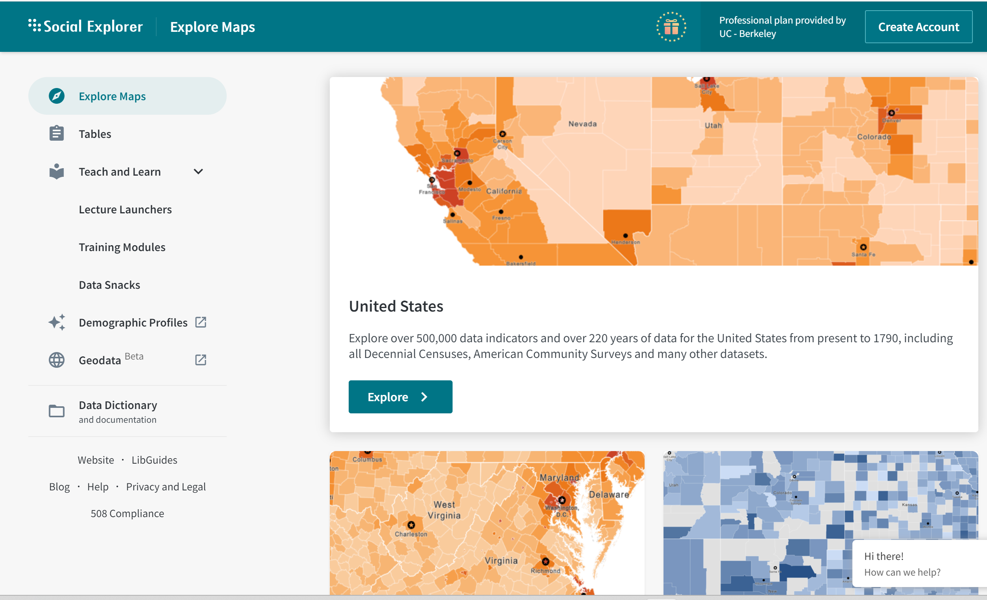
http://www.socialexplorer.com

Slide 11
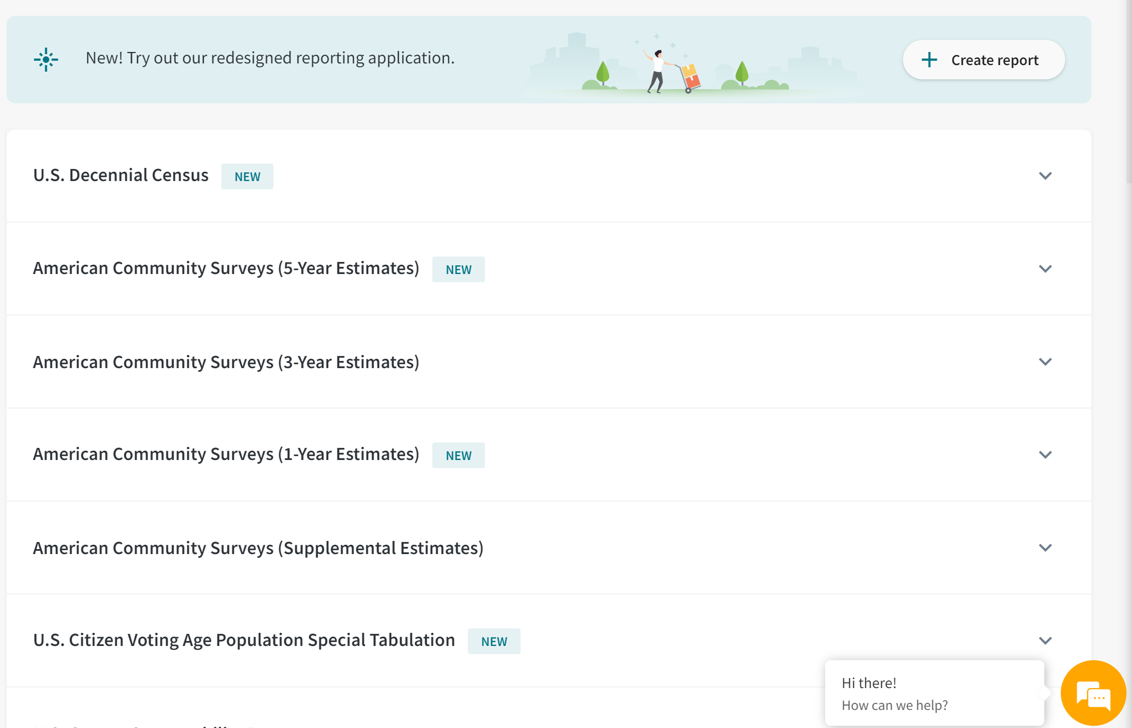

Slide 12
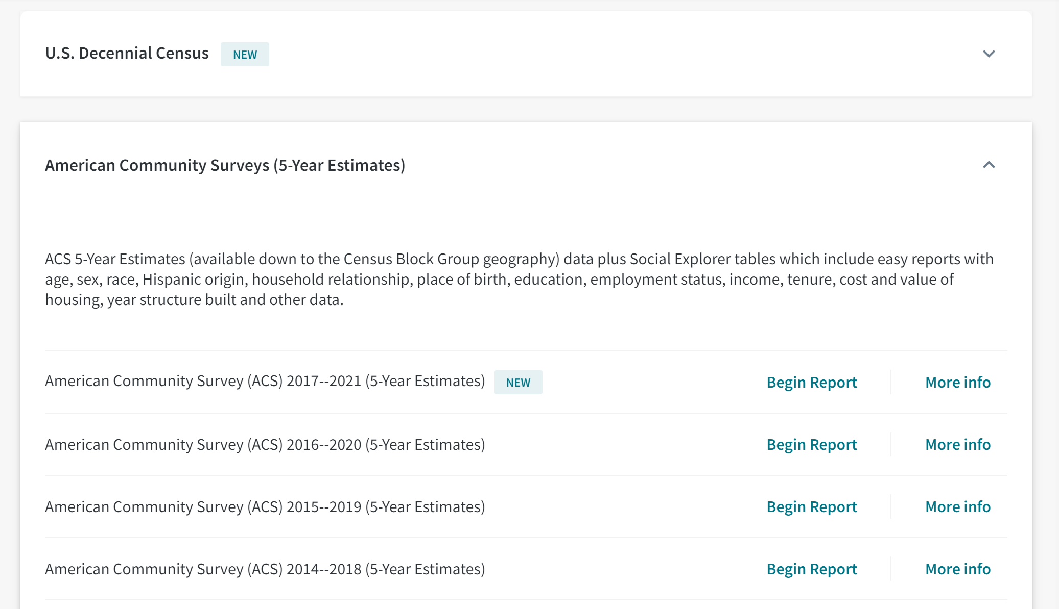

Slide 13
Social explorer – census tables
Start by selecting your geography
The Census calls cities “Place”
Select 160 ….. Place
Select Kansas in State
Scroll down to select Dodge city – then click ADD
Click Proceed to Tables >

Slide 14
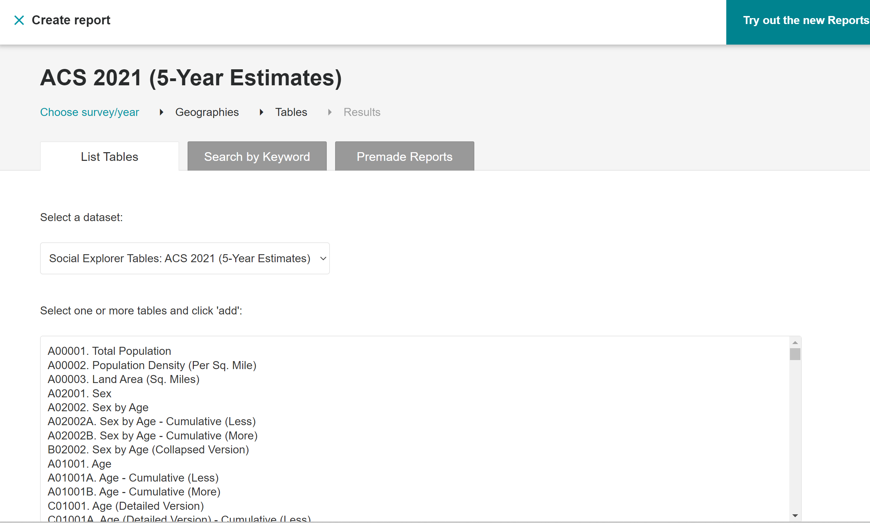
Social explorer – census tables

Slide 15
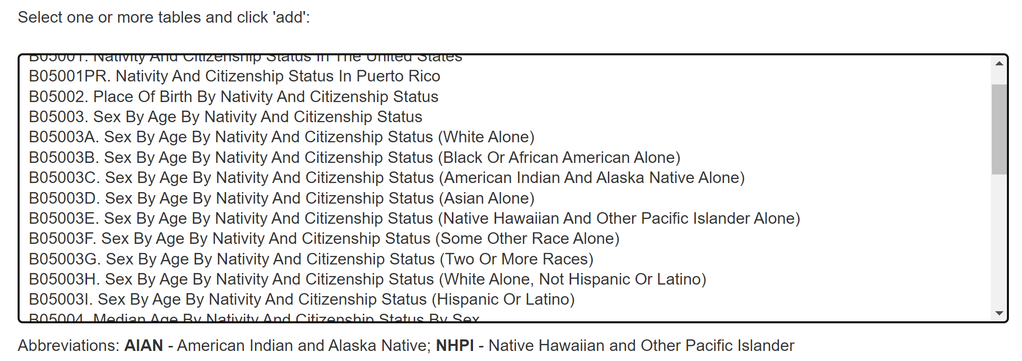
Social explorer – census tables
Getting Citizen Voting Age Population (CVAP)
In the “Search for:” box type in citizen and click Search
Select 3 types of Sex by Age by Nativity and Citizenship Status and then click “Add” and “Show Results”

Slide 16
Social explorer – census tables
You need the TOTAL CVAP first which becomes your new denominator for the entire jurisdiction
Next you need the total Latino CVAP (enumerator)
Next you need the total White, non-Hispanic CVAP (also enumerator)
Calculate what percent of the total CVAP is Latino and what percent is White

Slide 17
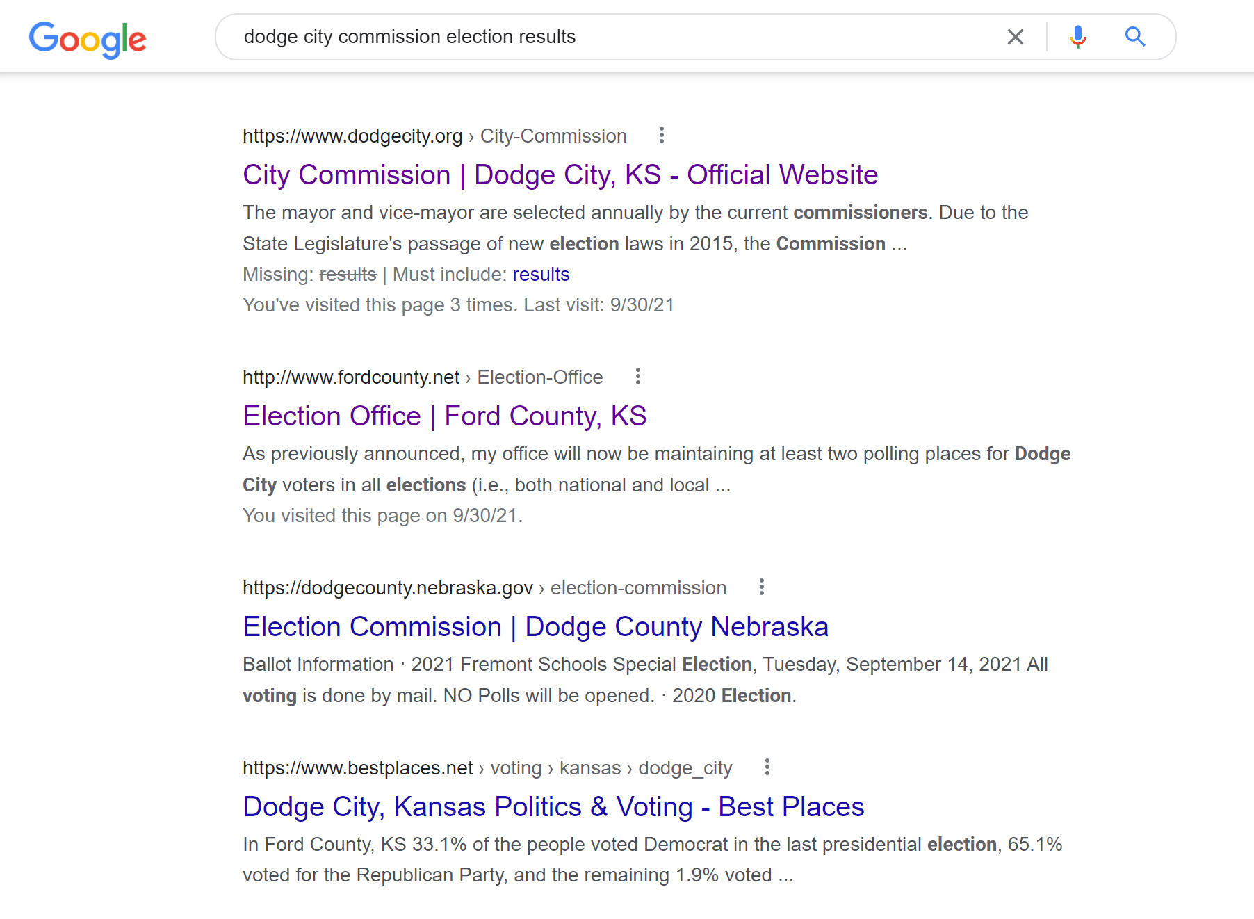
Reviewing election results
Most elections are run by County government

Slide 19
Assignments for next week
Start to provide detail on 2 jurisdictions
Start with Total Pop by Race
Include CVAP detail – Citizen Voting Age Population
List of incumbents, list of past challengers
Add election detail
Add additional factors to your jurisdiction
Read Arlington Heights v. Metropolitan Housing Authority decision for next week

Slide 20
THANK YOU!
Prof. Barreto: matt@uclavrp.org
Prof. Dunn: chad@uclavrp.org

